Slide 1
Lecture 5: using color and shading
Trevor A. Branch
tbranch@uw.edu
Beautiful graphics in R, FISH507H
SAFS, University of Washington

Slide 2
Video
Notes:
http://on.ted.com/Marshall

Slide 3
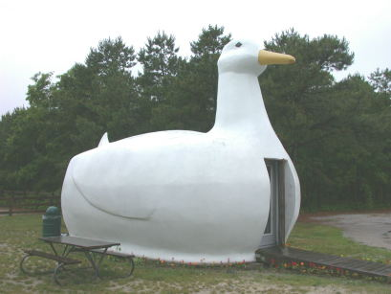
Chart ducks
“…warning of Pugin: It is all right to decorate construction but never construct decoration”
Photo: http://www.lukecole.com/Roadside%20Attractions/Mimetic/NY/BigDuck.htm
Tufte ER (2001) The visual display of quantitative information, p. 117

Slide 4
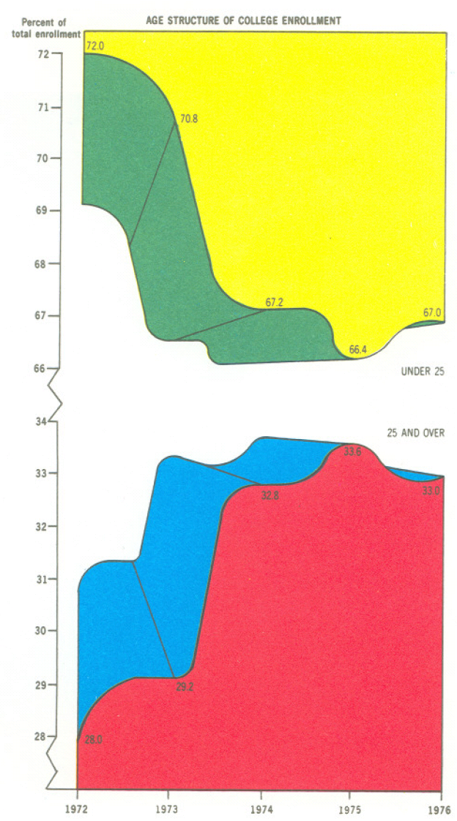
Age structure of college enrollment
Tufte: “this may well be the worst graphic ever to find its way into print”
Tufte: “If a picture is composed of two or more large, enclosed areas in different colors, then the picture falls apart. Unity will be maintained, however, if the colors of one area are repeatedly intermingled in the other....”
American Education magazine, 1970s
Tufte ER (2001) The visual display of quantitative information, p. 118
Notes:
Five colors report, almost by happenstance, only five pieces of data (since the division between each year adds to 100%)

Slide 5
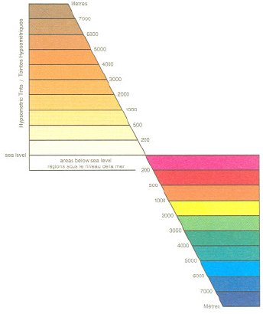
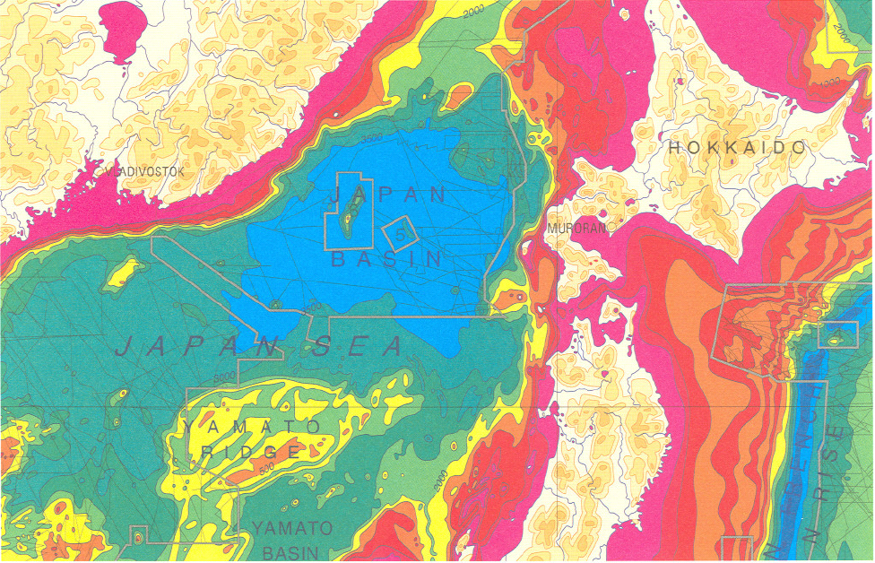
“Tufte: Don’t use up the entire color spectrum, or even all of a hue's levels. Particularly avoid ROYGBIV (red, orange, yellow, green, blue, indigo, violet), the color spectrum of the rainbow… one needs to constantly remind oneself which color means high vs. low values.”
Tufte ER (1997) Visual explanations, p. 76-77

Slide 6
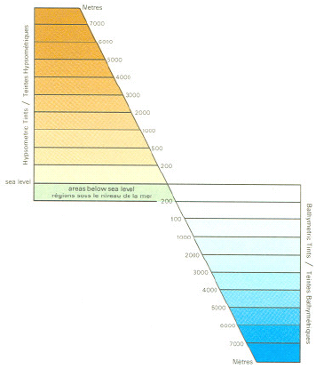
“Tufte: Placing of bright colors mixed with white produces unpleasant effects. Instead use colors found in nature, especially those on the lighter side.”
Tufte ER (1997) Visual explanations, p. 76-77

Slide 7
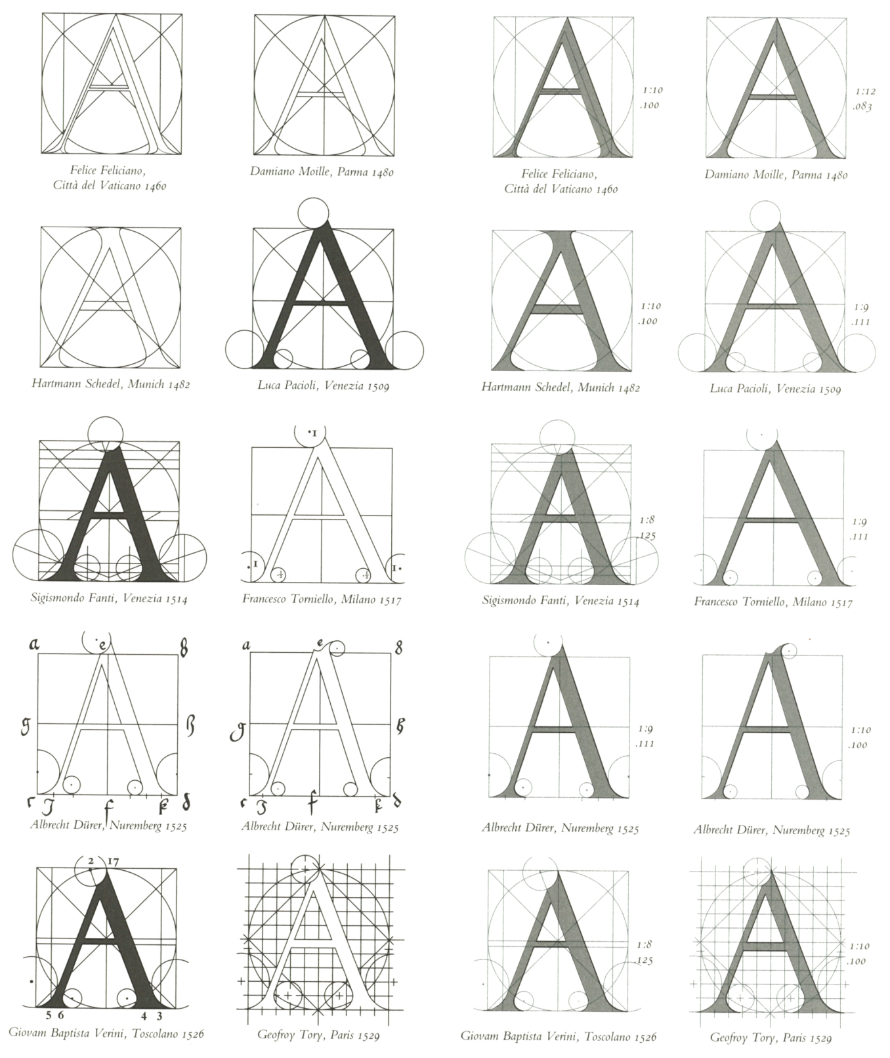
Tufte: subtle color shifts using thin gray lines
Tufte ER (1997) Visual Explanations, p. 113
Original
Revised (Tufte)

Slide 8
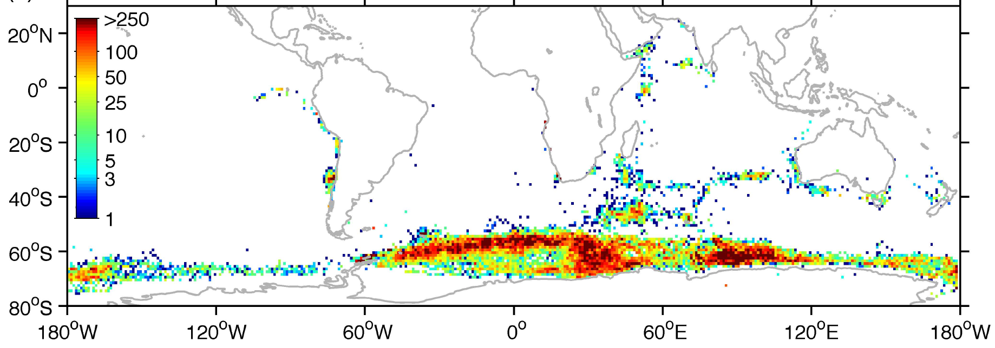
“Tufte: Don’t use up the entire color spectrum, or even all of a hue's levels. Particularly avoid ROYGBIV (red, orange, yellow, green, blue, indigo, violet), the color spectrum of the rainbow… one needs to constantly remind oneself which color means high vs. low values.”
Blue whale catches
Figure by Daniel Palacios, in Branch et al. (2007) Mammal Review 37:116-175

Slide 9
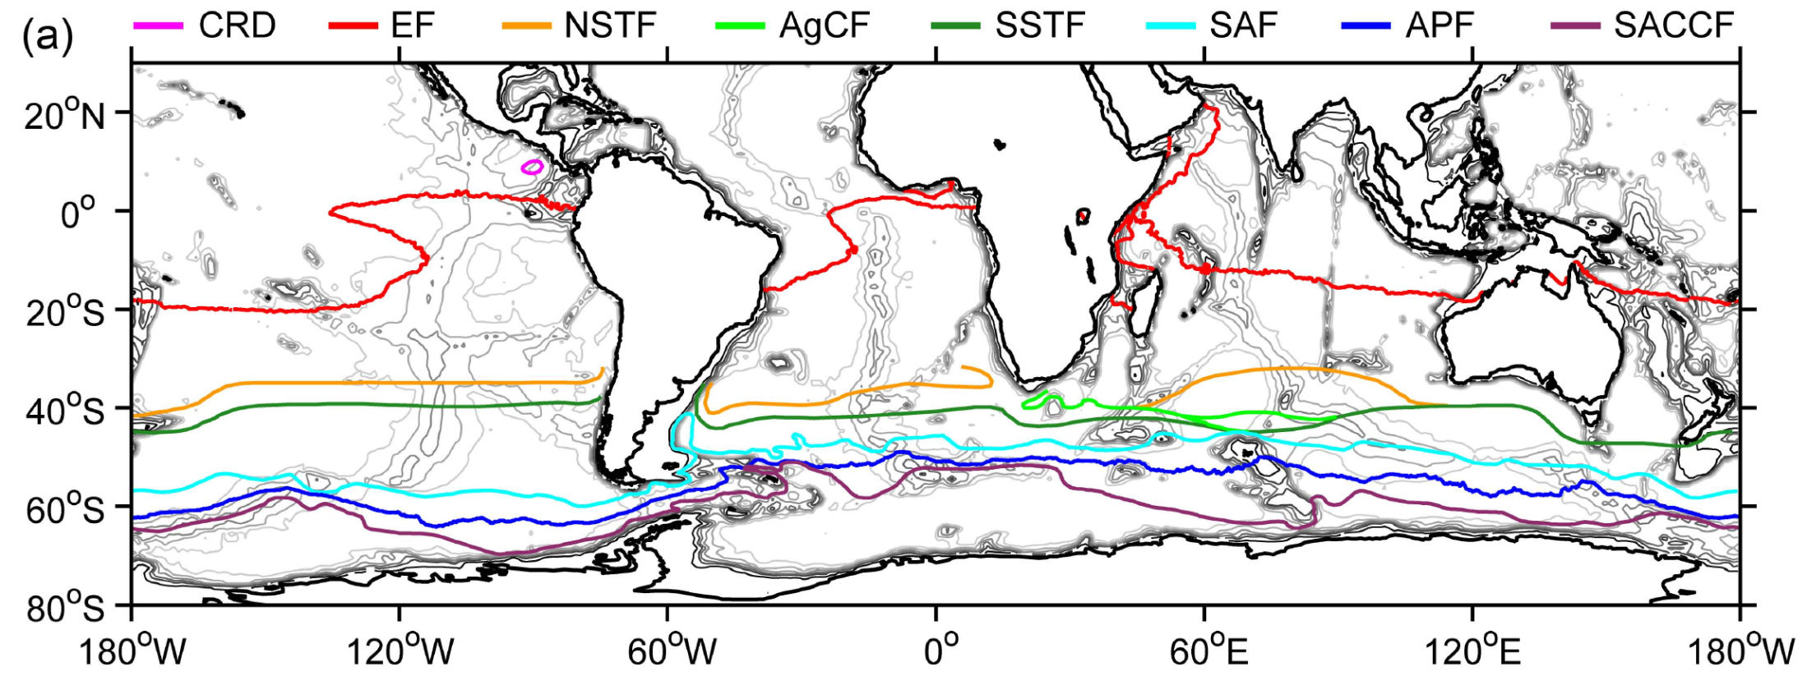
Tufte: “Color spots against a light gray or muted field highlight and italicize data”
“Note the effectiveness and elegance of small spots of intense, saturated color for carrying information.”
Bathymetry and oceanographic fronts
Figure by Daniel Palacios, in Branch et al. (2007) Mammal Review 37:116-175

Slide 10
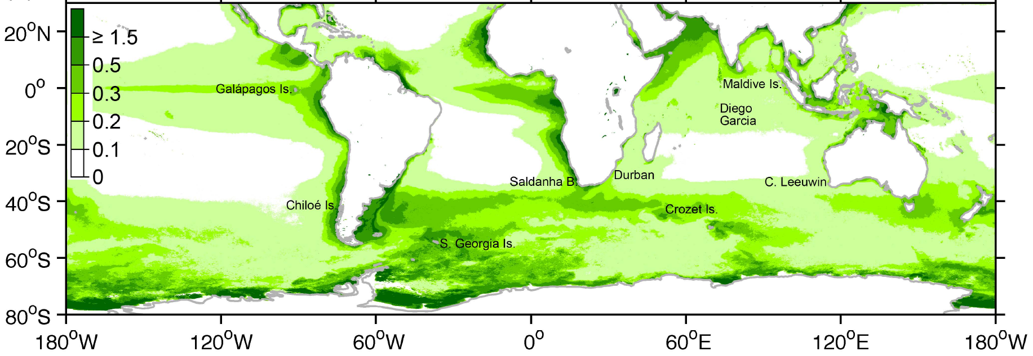
“Tufte: Using a single hue with variations in intensity allows instant interpretation”
Chlorophyll concentrations
Figure by Daniel Palacios, in Branch et al. (2007) Mammal Review 37:116-175

Slide 11
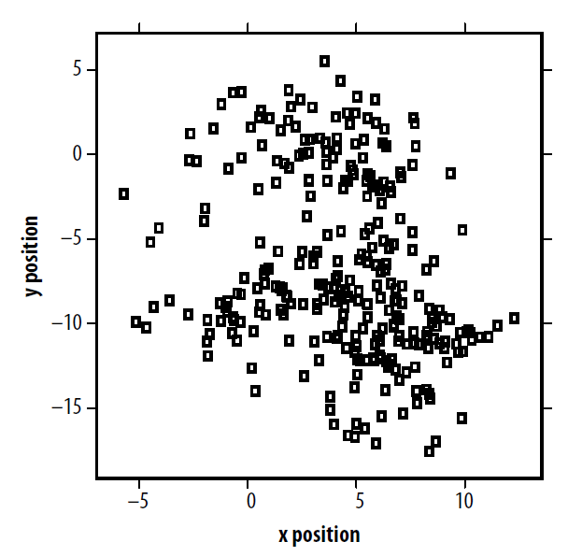
Pitches by baseball player Oscar Villarreal, 2008
M. Driscoll (2010) Color: the Cinderella of data visualization. pp. 59-67 in:
Steele & Ilinsky (eds) Beautiful visualization: looking at data through the eyes of experts.

Slide 12
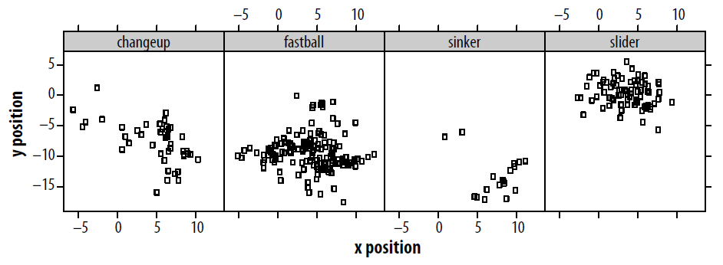
Small multiples
M. Driscoll (2010) Color: the Cinderella of data visualization. pp. 59-67 in:
Steele & Ilinsky (eds) Beautiful visualization: looking at data through the eyes of experts.

Slide 13
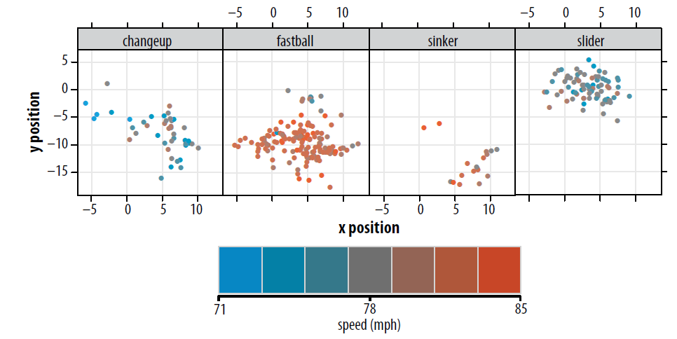
Adding color
M. Driscoll (2010) Color: the Cinderella of data visualization. pp. 59-67 in:
Steele & Ilinsky (eds) Beautiful visualization: looking at data through the eyes of experts.

Slide 14
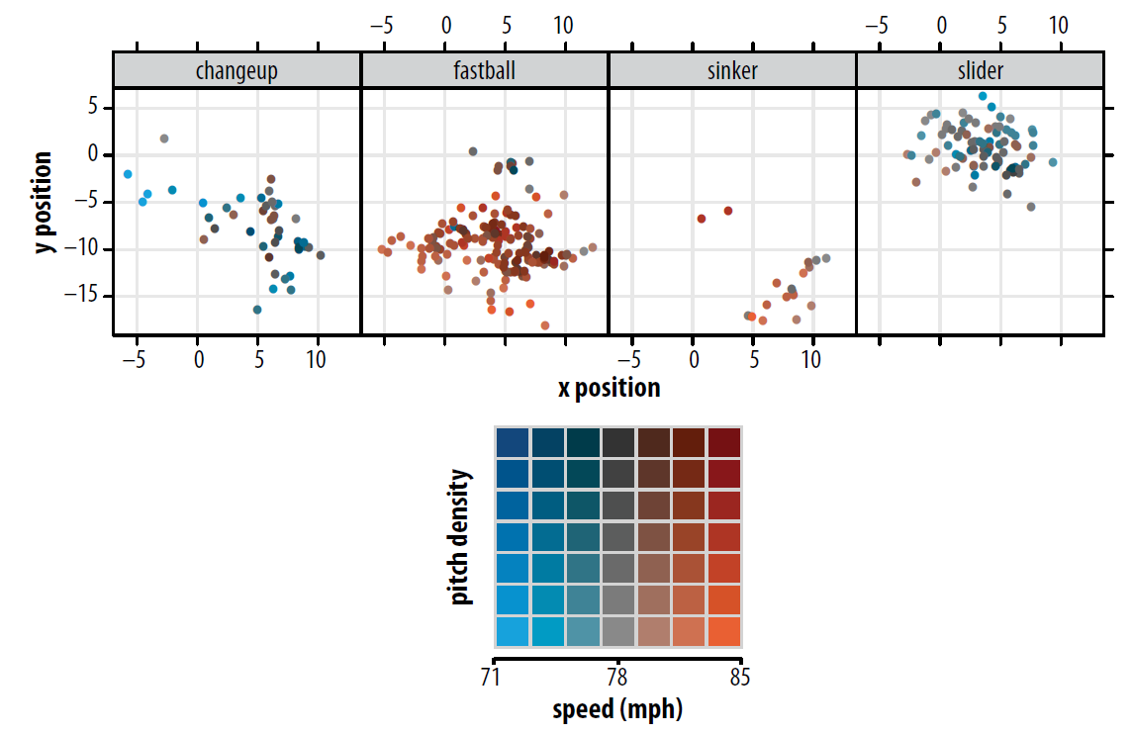
Adding luminosity
M. Driscoll (2010) Color: the Cinderella of data visualization. pp. 59-67 in:
Steele & Ilinsky (eds) Beautiful visualization: looking at data through the eyes of experts.

Slide 15
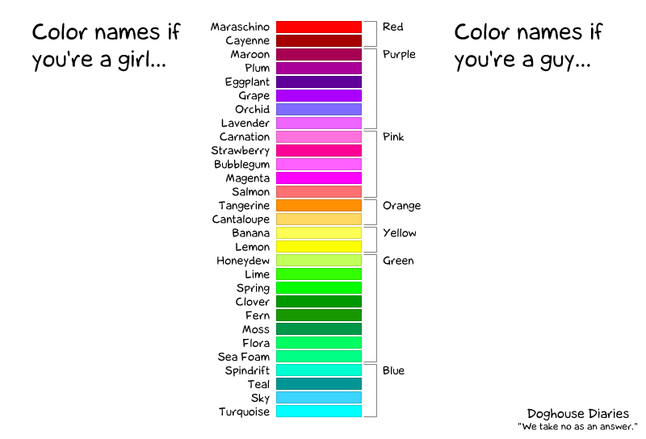
People perceive color differently
http://thedoghousediaries.com/1406

Slide 16
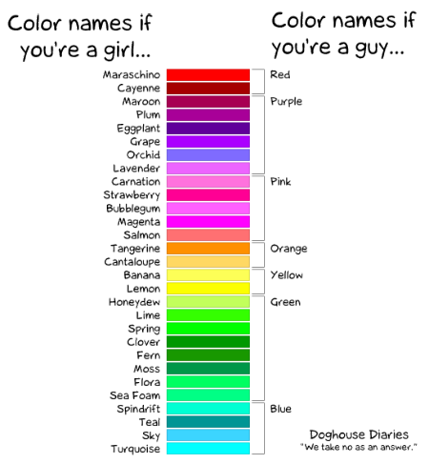
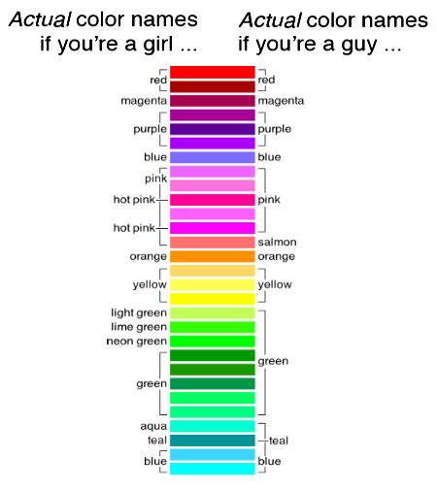
http://blog.xkcd.com/2010/05/03/color-survey-results/

Slide 17
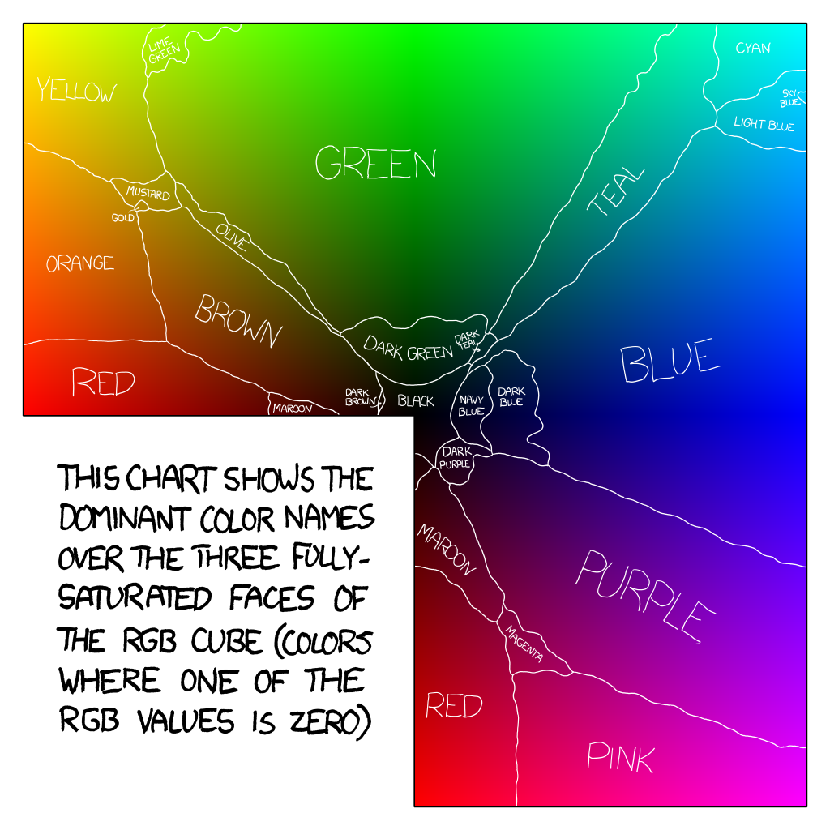
http://blog.xkcd.com/2010/05/03/color-survey-results/

Slide 18
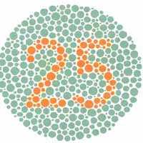
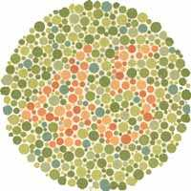
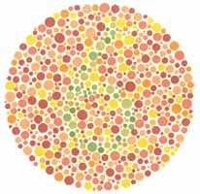
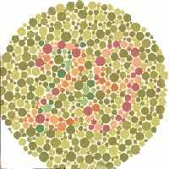
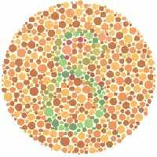
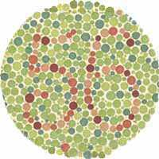
Color blindness: Ishihara test
25 is obvious
Nothing
Nothing
Nothing
Nothing
Can see 56 but
does not pop out
http://www.toledo-bend.com/colorblind/Ishihara.asp

Slide 19
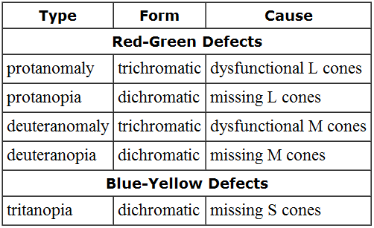
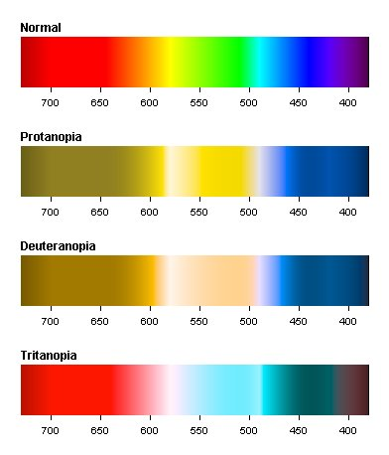
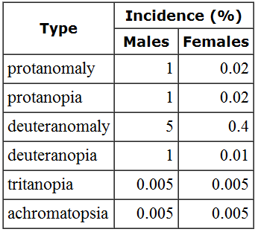
Color blindness
Missing “red” L cones (1%)
Missing “green” M cones (1%)
Missing “blue” S cones (0.005%)
R library “dichromat” has a function of the same name that displays colors in this way
Wolfmaier TG (1999) Designing for the color-challenged: a challenge
www.internettg.org/newsletter/mar99/accessibility_color_challenged.html
Notes:
white golf ball, flame orange (looks orange red), but out in golf course, much harder to spot

Slide 20
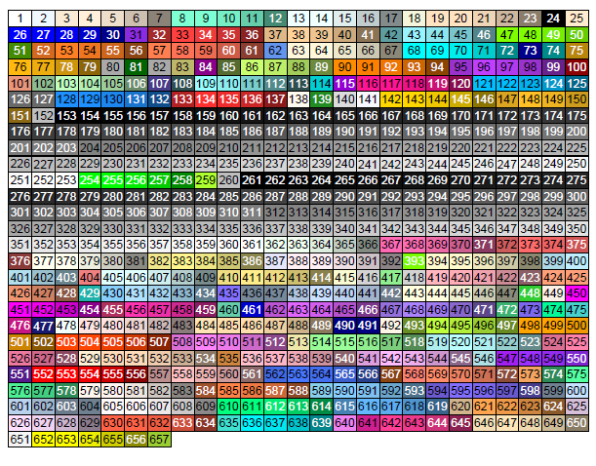
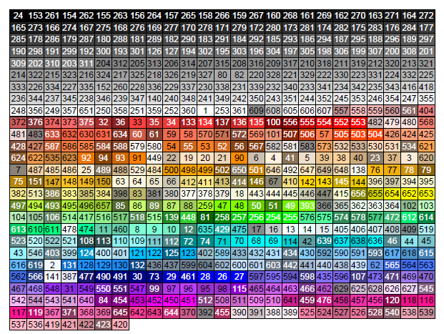
Finding colors in R
All named colors in R colors() are described in this pdf:
http://research.stowers-institute.org/efg/R/Color/Chart/ColorChart.pdf
Download it somewhere handy and refer to it often
e.g. colors()[554] is “red2”
Bilingual
“gray30” = “grey30”
colors() = colours()
Very useful
“gray0”, “gray1”, …, “gray100” (153-253)
Gives shading gradient from black to white
http://research.stowers-institute.org/efg/R/Color/Chart/ColorChart.pdf

Slide 21
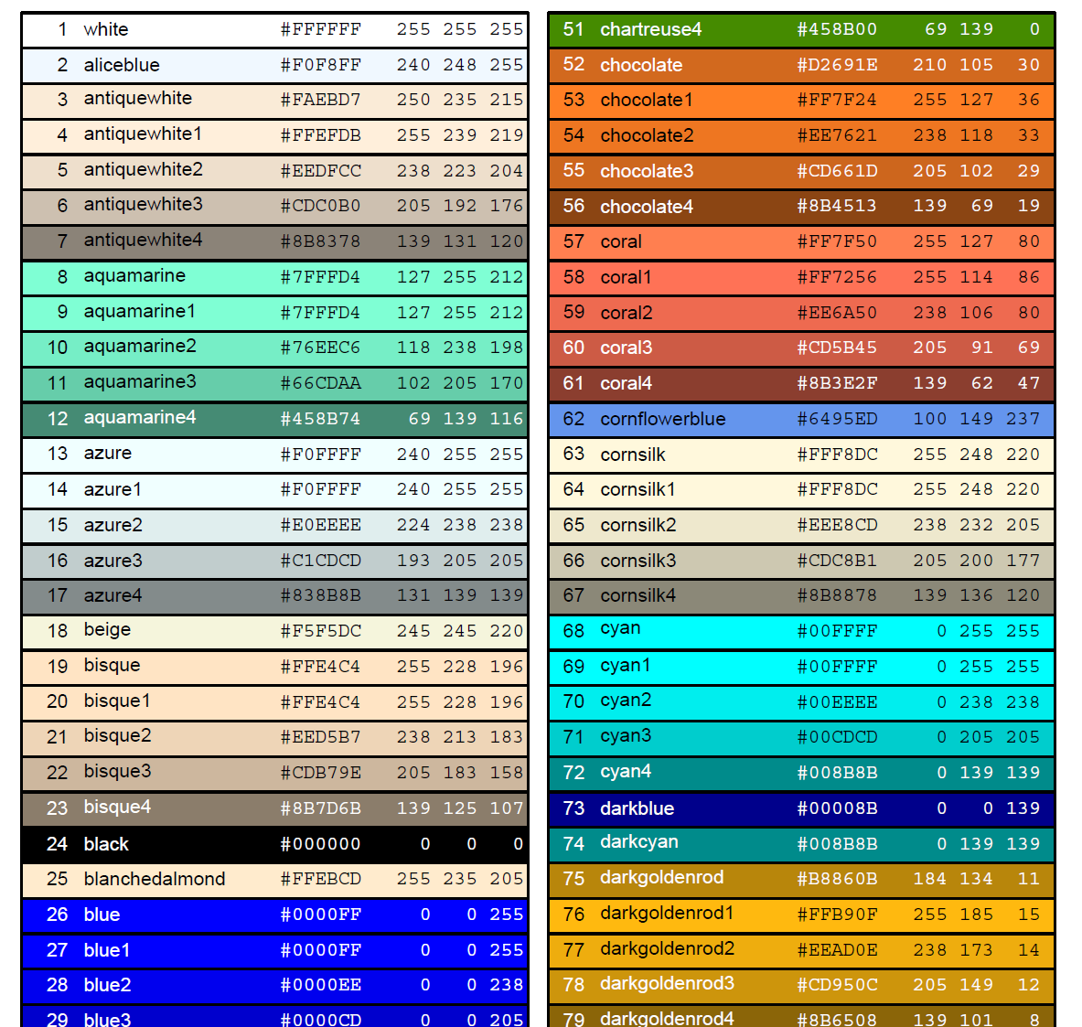
Identical in R
col=colors()[9]
col="aquamarine1"
col="#7FFFD4"
http://research.stowers-institute.org/efg/R/Color/Chart/ColorChart.pdf

Slide 22
Understanding hexadecimal colors
Dec | Hex
0 | 0
1 | 1
2 | 2
3 | 3
4 | 4
5 | 5
6 | 6
7 | 7
8 | 8
9 | 9
10 | A
11 | B
12 | C
13 | D
14 | E
15 | F
16 | 10
17 | 11
18 | 12
19 | 13
20 | 14
Decimal (base-10)
765 = 7×10² + 6×10¹ + 5×10⁰ = 765
Hexadecimal (base-16)
765 = 7×16² + 6×16¹ + 5×16⁰ = 1893 [in base-10]
Letters A-F represent numbers 10-15.
Thus 6FA = 6×16² + 15×16¹ + 10×16⁰ = 1786 [in base-10]
238
red
173
green
14
blue
red
green
blue
Gray colors
Equal amounts of red, green and blue result in gray shades:
"#A1A1A1" = "gray63“
Note: format.hexmode(255) converts decimals to hexadecimal numbers, so does sprintf('%X',255)
http://research.stowers-institute.org/efg/R/Color/Chart/ColorChart.pdf

Slide 23
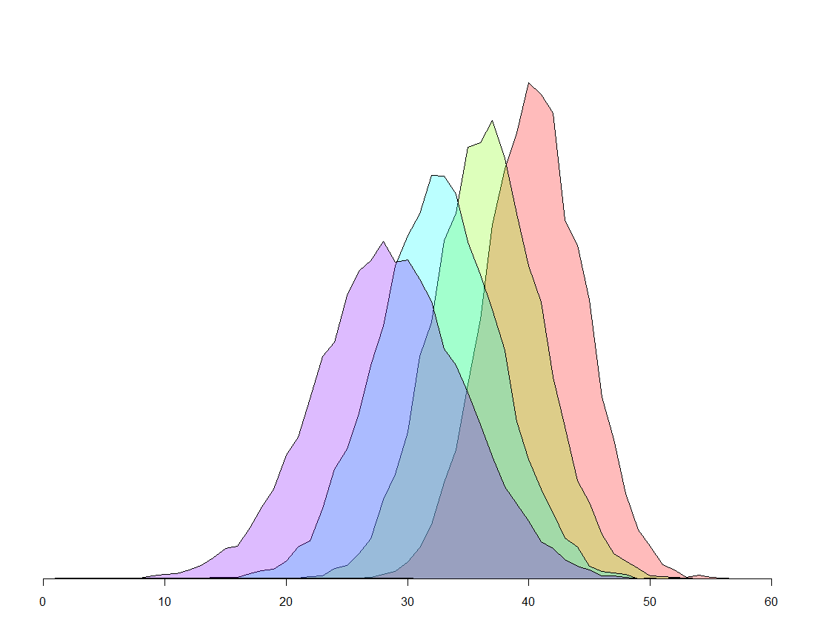
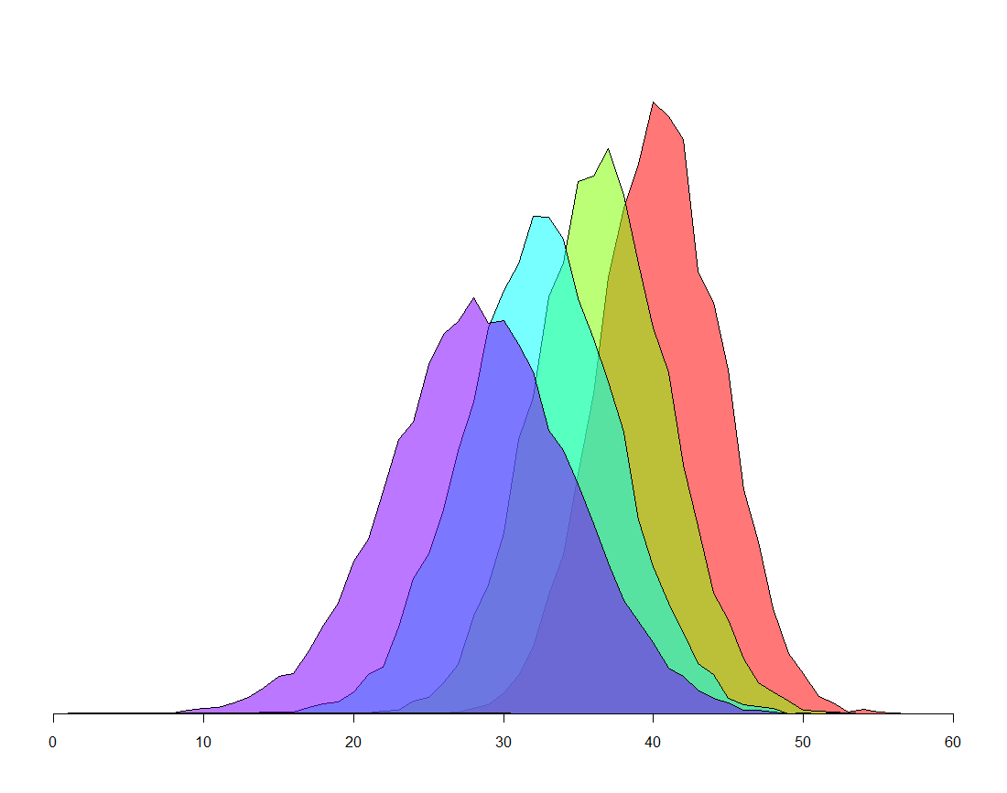
Transparent colors in R
Add two hexadecimal values to the end of the string
#FF0000 red (255 red 0 blue 0 green)
#FF000000 totally translucent
#FF000044 quite translucent
#FF000088 quite opaque
#FF0000FF totally opaque (default for colors in R)
All colors
ending in
“44”
All colors
ending in
“88”

Slide 24
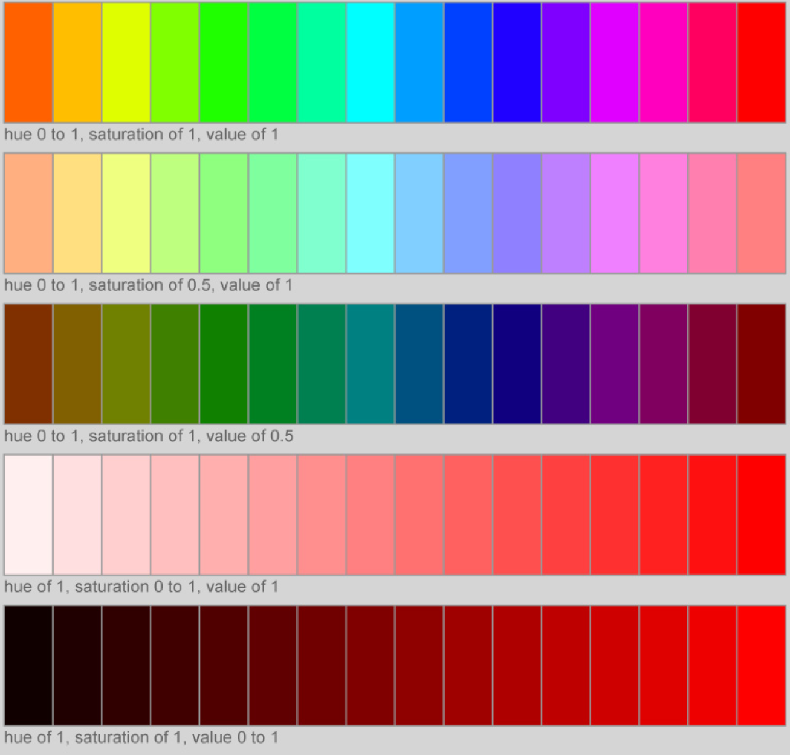
Using HSV instead of RGB
RGB specifies red-green-blue
HSV specifies hue-saturation-value
hsv(h, s, v, gamma, alpha) where gamma is color correction, alpha is transparency
http://students.washington.edu/mclarkso/documents/colors%20Ver2.pdf

Slide 25
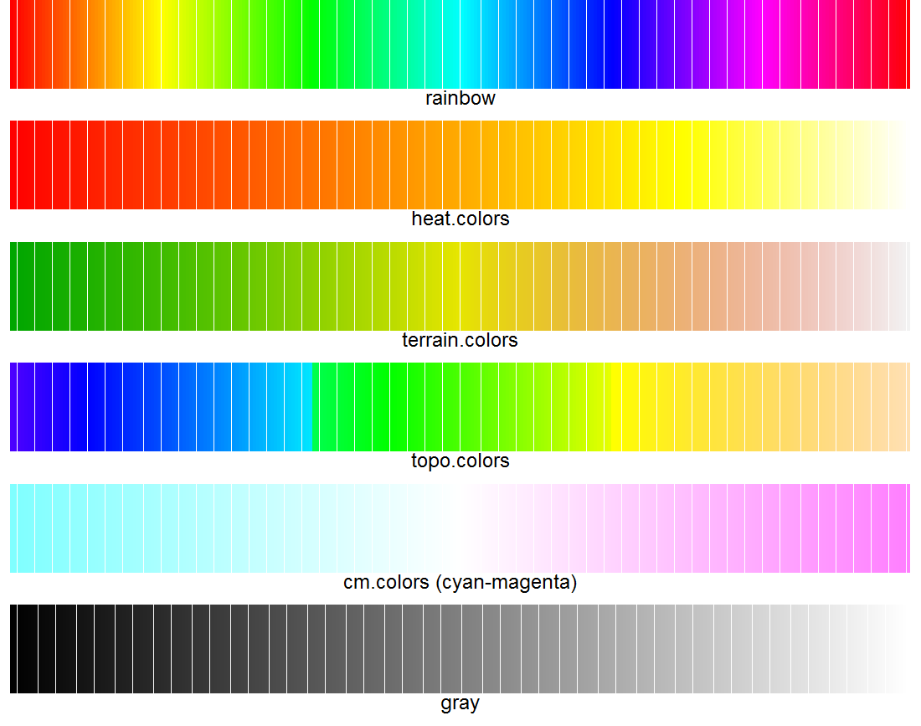
Palettes
For example:
col=rainbow(50)
col=heat.colors(50)
col=terrain.colors(50)
col=topo.colors(50)
col=cm.colors(50)
But:
col=gray(0:50/50)
Creates a vector of 50 evenly spaced colors from the chosen palette
http://research.stowers-institute.org/efg/Report/UsingColorInR.pdf

Slide 26
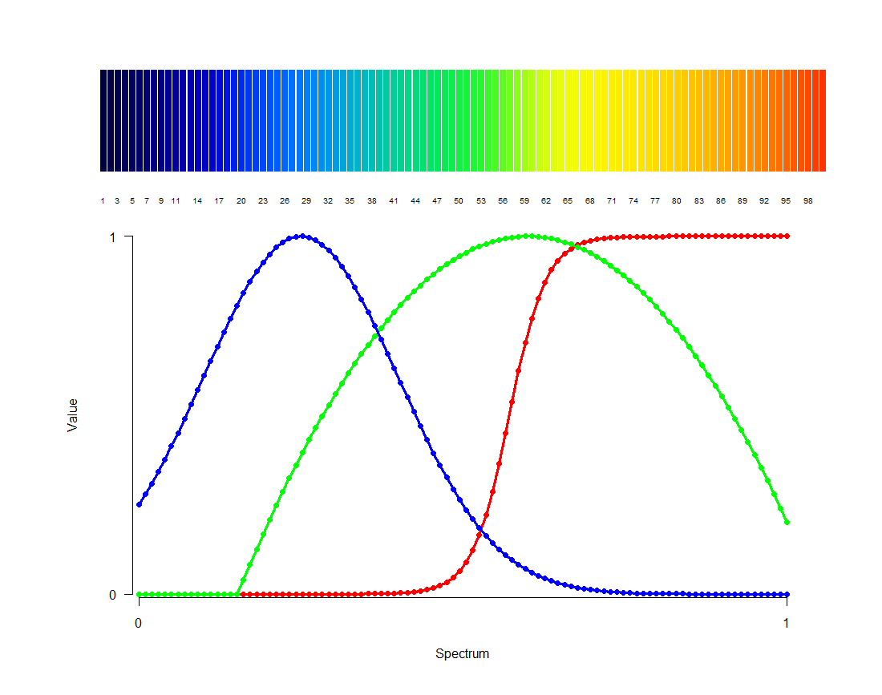
rich.colors: much prettier than rainbow
library(gplots)
col=rich.colors(100)
R help file for rich.colors, by Arni Magnusson, former SAFS student

Slide 27
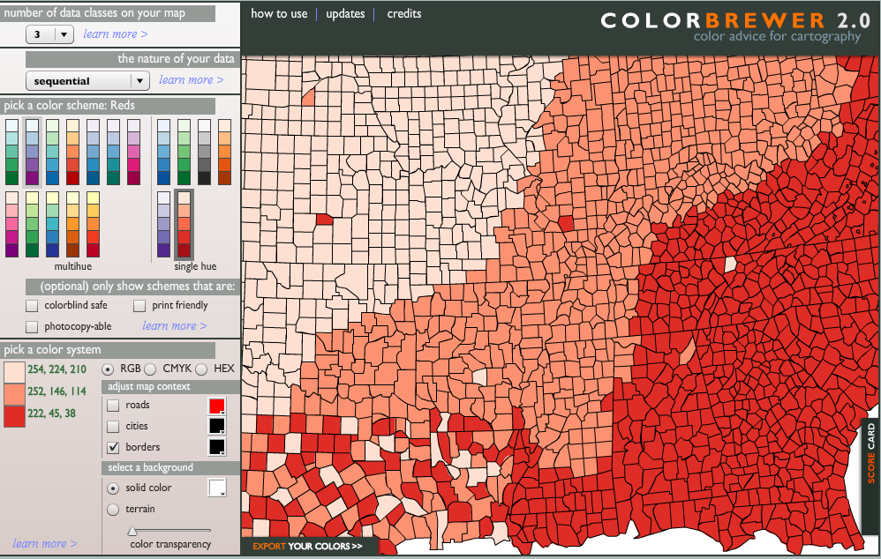
http://colorbrewer2.org/
R package “RColorBrewer”

Slide 28
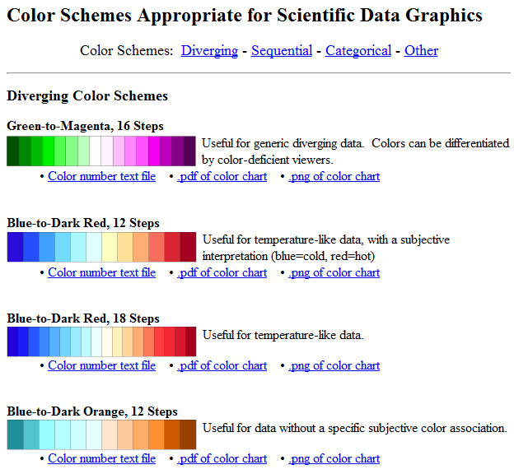
http://geography.uoregon.edu/datagraphics/color_scales.htm
Diverging color schemes
(also sequential, categorical, other)

Slide 29
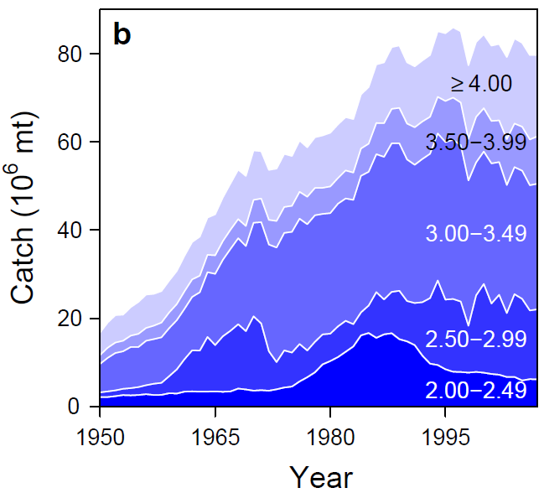
Custom palettes
blue.pal <- colorRampPalette(c("blue", "white"))
blue.cols <- blue.pal(n=6)[1:5]
polygon(..., col=blue.cols[i])
Branch et al. (2010) Nature 468:431-435

Slide 30
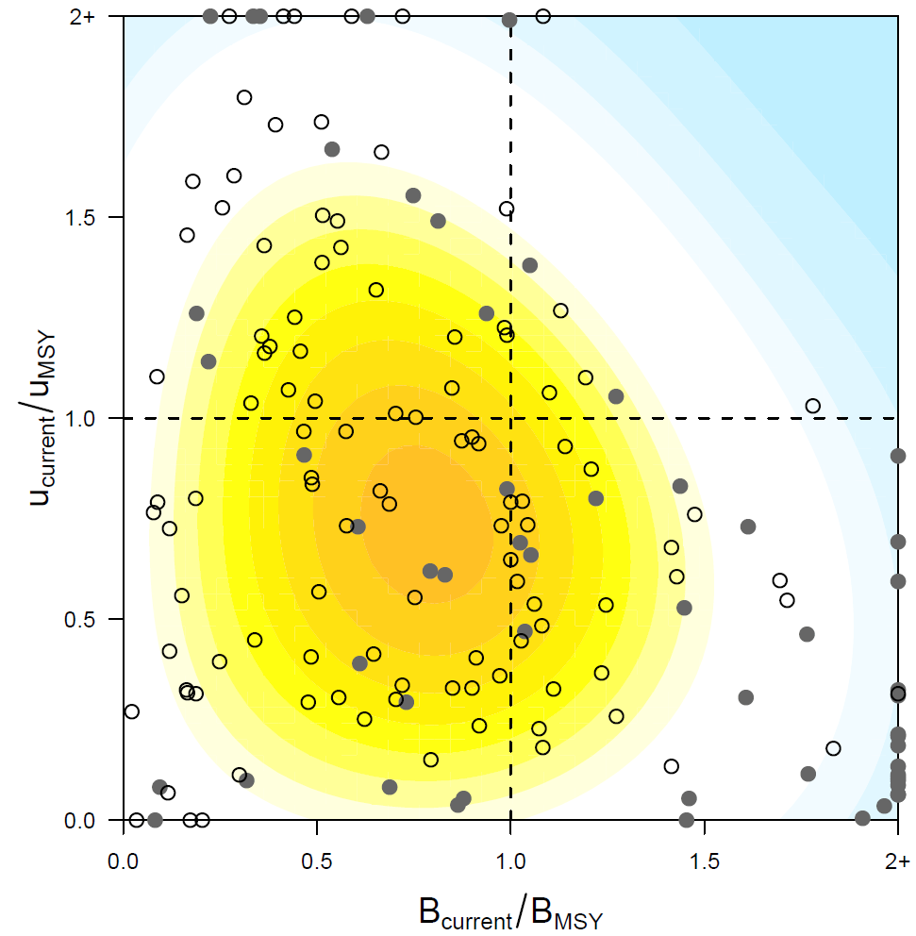
paletteable.egg <- colorRampPalette(c("#BFEFFF","white","white","yellow","#FFC125"))
filled.contour(..., color.palette = paletteable.egg)
Worm et al. (2009) Science 325:578-585

Slide 31
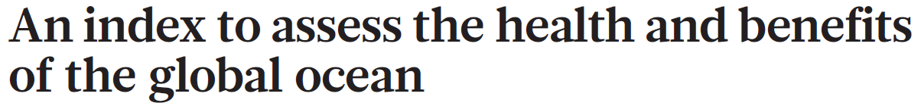
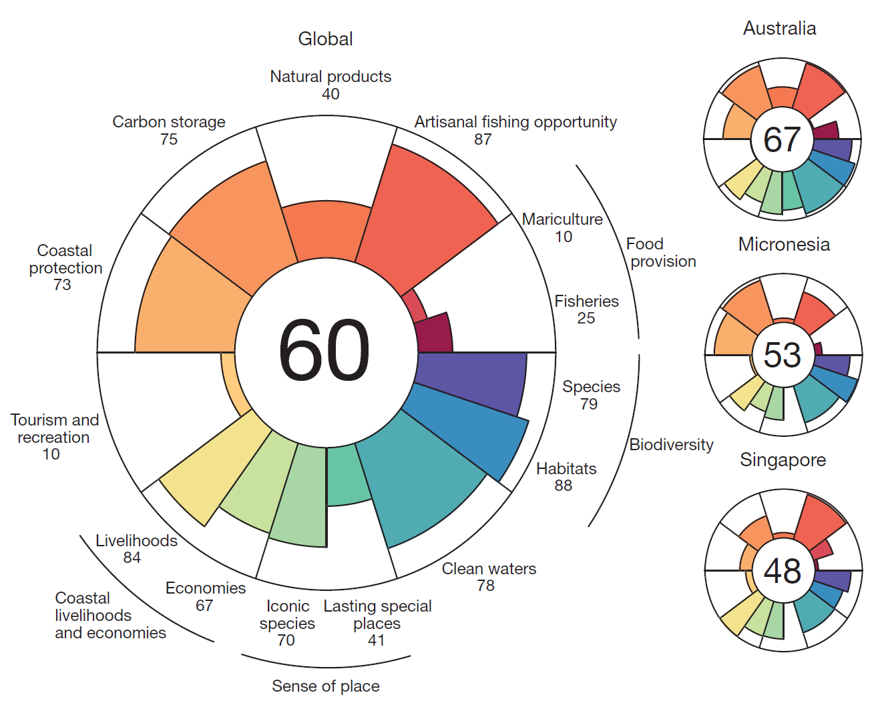
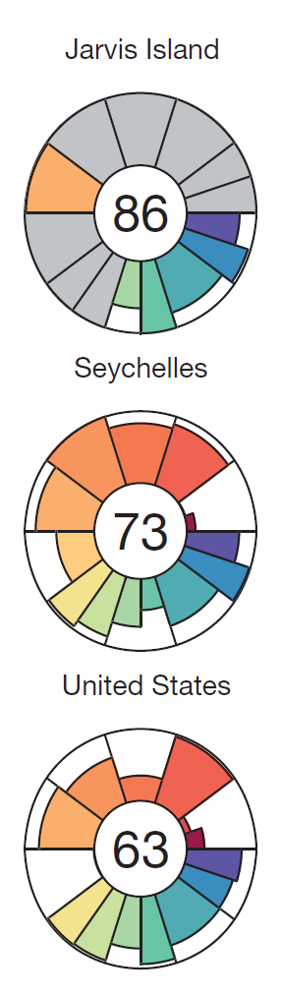
Halpern et al. (2012) Nature 488:615-620 http://www.oceanhealthindex.org/

Slide 32
Acknowledgements
Ideas and R code for some slides from:
http://research.stowers-institute.org/efg/Report/UsingColorInR.pdf
http://research.stowers-institute.org/efg/R/Color/Chart/ColorChart.pdf
Arni Magnusson: for inventing rich.colors()
Melissa Clarkson for R color guide
http://students.washington.edu/mclarkso/documents/colors%20Ver2.pdf

